Slide 1
Real Time System
Lecturer: Er. Saroj ghimire
Qualification: Msc.CSIT, BE(COMPUTER)
Lincoln University College

Slide 2


Overview
Basic concept in real time communication
Soft and hard real time communication system
Model of real time communication
Internet and resources reservation protocols
Real time protocol

Slide 3
Objectives
Understanding real time system communication model
Dealing with resource reservation protocol
Capturing concept of real time protocol

Slide 4
Basic concept in real time communication
Real time communications is the near simultaneous exchange of information over any type of telecommunications service from the sender to the receiver in a connection with negligible latency
Examples of real time communications include:
  Voice over landlines and mobile phones
  VoIP
  Instant messaging (e.g., WhatsApp, WeChat),
  Video and teleconferencing
  Robotic telepresence

Slide 5
Basic concept in real time communication
Focus is on messages exchanged among applications on different hosts
The source and destinations of every message are application tasks residing on different hosts
The network interface of each host contains an input queue and output queues (buffers)
We assume that these queues are jointly maintained by two servers :
  The Transport Protocol handler (TP)
  It interfaces with local applications and provides them with message transport services
  Network Access Control (NAC) handler
  It interfaces with the network below and provides network access and message transmission services to the TP handler
  When requested to send a message by a local application task, the source TP handler places the message in the output queue
  From there, each outgoing message is delivered to the network under the control of the source
NAC handler
  After the message has traversed the network , the destination NAC handler places the message in the input queue and notifies the destination TP handler
  The destination TP handler then moves the message to the address space of the destination
  Application task and notifies the application task of the arrival of the message
  Messages are typically fragmented into segments for their transmission thru the communication
  network
  Each segment is handled by the network as a basic transmission unit and the transmission of the unit is non preemptable. Such a unit is called a frame , a packet, a cell etc
  e.g. a packet is a 53 byte cell in an ATM network, 64 bytes in case of ethernet

Slide 6
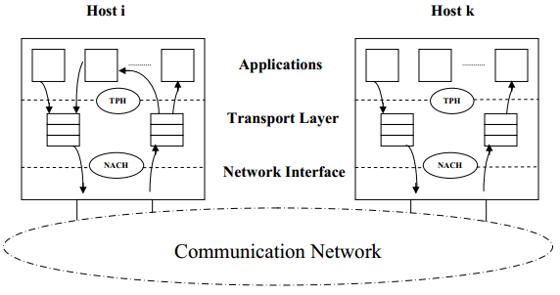

Slide 7
Internet and resources reservation protocols
Hosts and routes must reserve resource needed in order to deliver the desired quality of service to users through interconnected networks,
Traditional congestion control mechanism do not work well but admission control and resource reservation provide an effective means to prevent congestion
Resource Reservation Protocols determines how hosts and routers operate and interact for the purpose of resource reservation
It assumes that the routes used to support the multicast tree of every source are chosen according to the routing protocols of the network
The output links used by each router to multicast messages from the source are given by a routing table of the routing module which is kept up to date during network reconfiguration

Slide 8
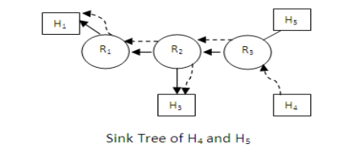
Internet and resources reservation protocols (cont)
Admission of new multicast connections and mapping between application and network quality of service parameters are handled by an admission control module and packet classifier
The resource reservation protocol establishes and maintains a sink tree for each destination and uses it to send control messages from the destination
A sink tree is a spanning tree that is routed at the destination and connects all the sources in the multicast group
It is obtained by tracing in the reverse direction from the destination to every source along the paths in the multicast tree of the source
Each destination is responsible for the initiation and maintenance of resource reservation on its own behalf

Slide 9
Real time protocol
It is a data transport protocol for real time applications, designed to support multicast communication in interactive multimedia applications such as audio and video teleconferencing and distributed simulations
It deals solely with data delivery and uses services (multicast routing, resource reservation and quality of service guarantee) provided by lower layer protocols.
RTP can run on unreliable datagram protocol UDP. It uses UDP‟s multiplexing and error control services and compensates UDP with its own sequencing function
Monitoring, control and identification functions are provided by RTCP
RTP is designed to be scalable from a few participants to thousands of participants in multicast communication and to be able to accommodate heterogeneity of sources, receivers and networks
Like RSVP , RTP also assumes that multicast group membership may change dynamically In contrast with TCP which is separate from application, RTP is often integration with application,
By providing headers that can be modified and expanded the protocol can be tailored by applications

Slide 10
Real time protocol
According to RTP audio and video data are transmitted separately
Each medium uses a separate multicast network address and a pair of UDP ports one for data packets and one for control packets
The combination of the network address and port is a destination transport address so each medium uses a pair of transport destination addresses
During the conference each chunk of audio or video data ( a segment of audio or an image) from each participant is framed by an RTP header to form an RTP packet
The need for sequence and timing information arise from the fact that RTP packets on a session may be lost and delivered out of order
Timing information also makes it possible for the destination to synchronize the associated audio and video

Slide 11
Further Readings
Brian W. Kernighan and Dennis M. Ritchie, The C Programming Language, Prentice Hall, 1988.
Data Structures and Algorithms; Shi-Kuo Chang; World Scientifi c.
Data Structures and Effi cient Algorithms, Burkhard Monien, Thomas Ottmann, Springer.
Kruse Data Structure & Program Design, Prentice Hall of India, New Delhi
Mark Allen Weles: Data Structure & Algorithm Analysis in C Second Adition. Addison-Wesley publishing
RG Dromey, How to Solve it by Computer, Cambridge University Press.
Shi-kuo Chang, Data Structures and Algorithms, World Scientifi c
Sorenson and Tremblay: An Introduction to Data Structure with Algorithms.
Thomas H. Cormen, Charles E, Leiserson & Ronald L. Rivest: Introduction to Algorithms.
Prentice-Hall of India Pvt. Limited, New Delhi Timothy A. Budd, Classic Data Structures in C++, Addison Wesley

